Slide 2
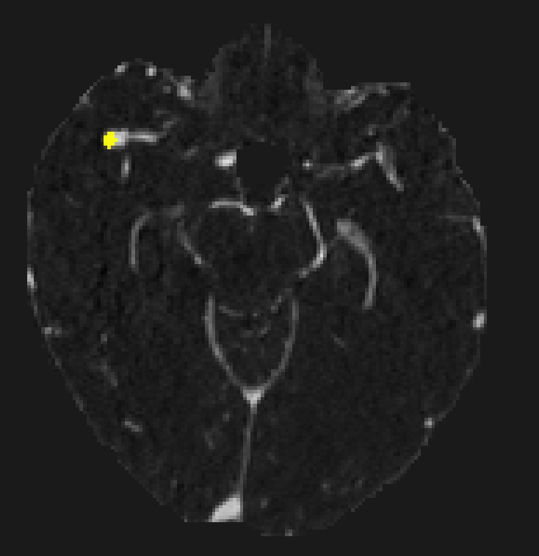

False positive case 033 : MCA bifurcation aneurysm
Notes:
False positive DVA

Slide 3
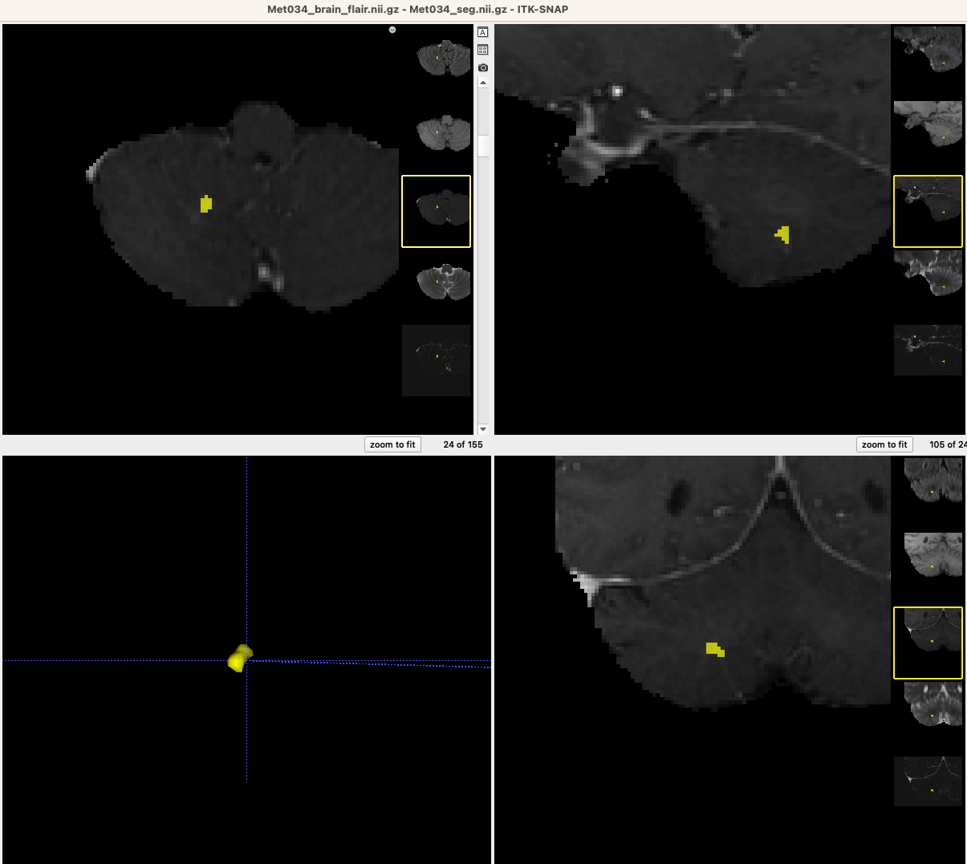
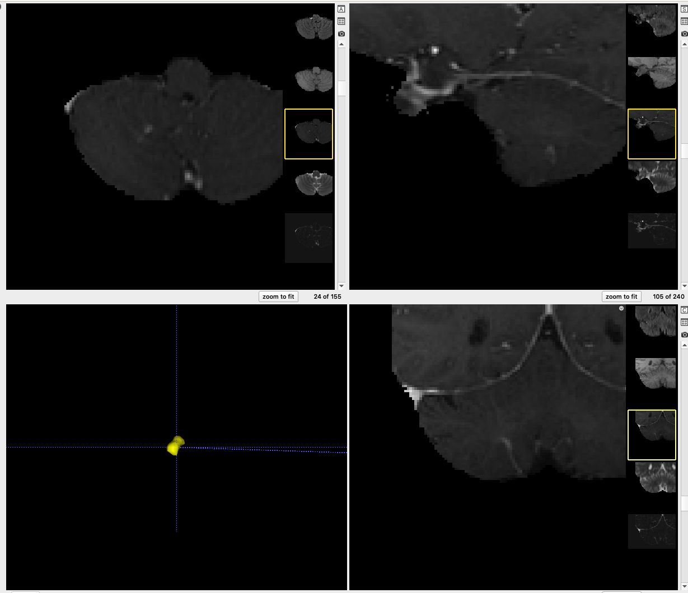
False positive case 034 : DVA
Notes:
False positive DVA

Slide 4
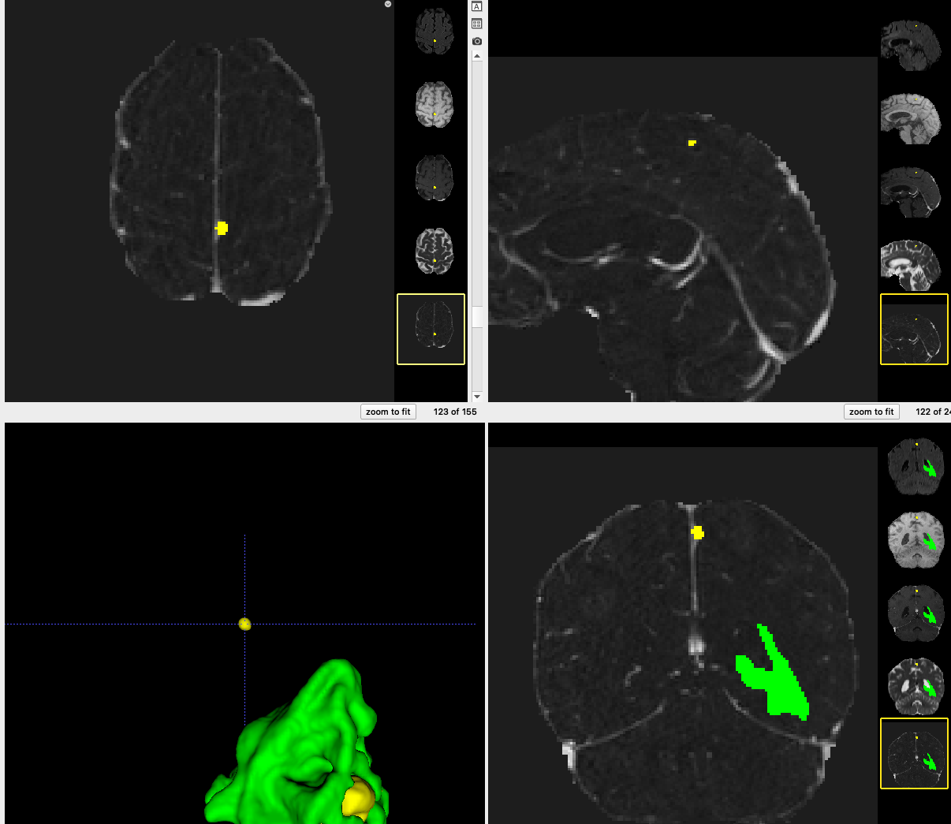
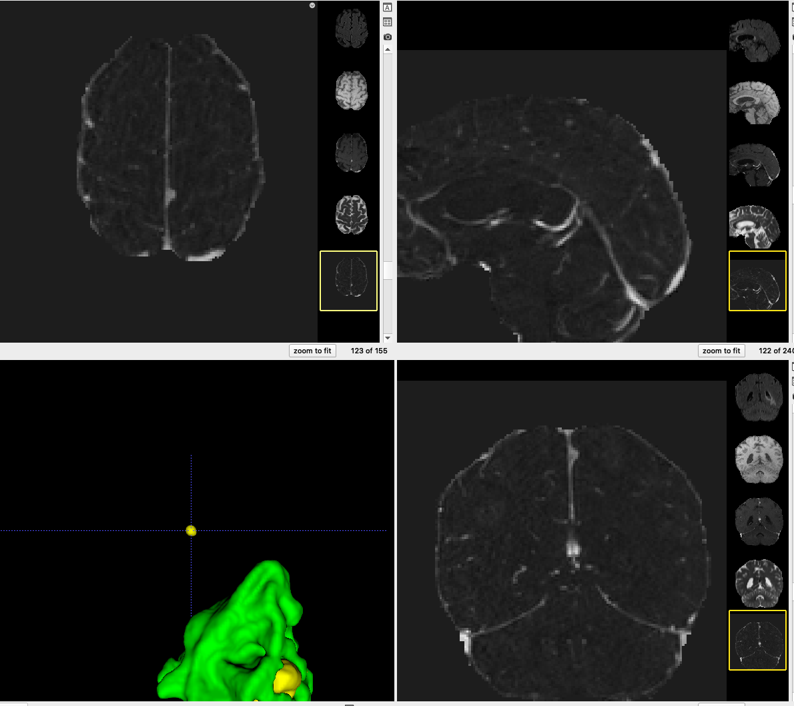
False positive case 035 : Meningioma ? (vs dural metastasis ?)
Notes:
False positive DVA

